Slide 1
C++ Programming
Jerry Lebowitz

Slide 2

Error Handling “Exceptions”

Slide 3

Exceptions Handling in C++
Provides a facility for a systematic object oriented approach to handling runtime errors
Can also handle runtime errors generated by C++ classes
One piece of code “throws” an exception that is “caught” by another piece of calling code that is willing to “handle” the error
Exceptions do not require parameters and are therefore suitable for use with constructors and operators

Slide 4
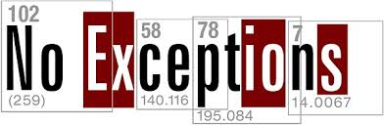
Exceptions Overview
Not all exceptions can be handled by a program
Inadvertently overwriting of memory is handled by the operating system
Terminates the application
Exceptions may also be defined as situations in which undesirable results happen

Slide 5

Handling Exceptions
One way to handle errors in functions is to return a signal or flag
Function return value
Some I/O functions (like fopen (opening a file)) return a “–1” when an error occurs
An “if” statement is required after each function invocation to check for an error
errorCode = myFunction( ...);
if (errorCode != 0)
Do something……...

Slide 6

Typical Problem Handling Exceptions
It is difficult for some functions (like finding the maximum or minimum of two numbers) to return a meaningful error value
“-1” may be the maximum or minimum

Slide 7
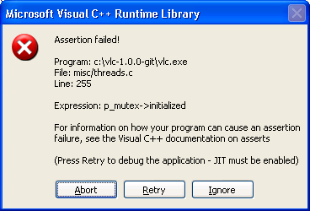
The assert Macro (1)
A great debugging tool
When an expression fails to meet a criteria (could be input data), a window pops up, execution stops with an error message along with an awful sound
The line number where the expression fails appears in a window
This failure is highly visible

Slide 8
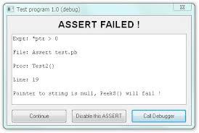
The assert Macro (2)
Not a good technique of running production programs since one should write a more friendly error handling routine
If the #NDEBUG appears before the include of <cassert>, the asserts are ignored
See examples: assert1.cpp and assert2.cpp

Slide 9

Exceptions Definitions
Exceptions
Unpredictable result that requires special handling
Exception Handler
Code that is executed when a particular exception occurs
Throw
To signal the fact that an exception has occurred
Catch
To process a thrown exception

Slide 10
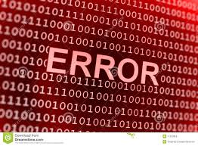
Class Exceptions
The problem is more complex when using classes
Question?
How can an application find out if an error occurred when an object is instantiated or destroyed?
Remember that constructors and destructors are implicitly called
They cannot return a value

Slide 11

try blocks (1)
A block of code explicitly prefixed by the keyword “try”
All the statements that might cause an error are enclosed within “try” blocks
Enclosed by opening and closing braces
Preceded by the “try” keyword
Not all the code needs to be in a try block
One can have many try blocks within a program

Slide 12

try blocks (2)
Applications generally do not know which statement caused the exception
If it wants to recover from the error, it may need to start over at the start of the try block
Exceptions can only be caught by code inside a try block

Slide 13
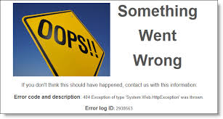
Function Nesting
The statement that causes an exception need not be located directly in the try block
It can be in a function that was invoked within the try block
It can be in a function invoked by a function within the try block
The try block can be established at the beginning of a program

Slide 14
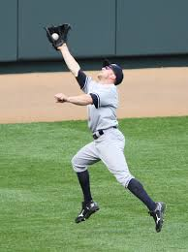
Catch Blocks (Exception Handlers) (1)
A block of code explicitly prefixed by the keyword “catch”
The code that handles the exception
Enclosed by opening and closing braces
Preceded by the keyword “catch”
The code inside a catch block is executed whenever an exception of the appropriate type is thrown inside a preceding try block

Slide 15
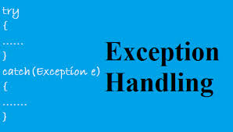
Catch Blocks (Exception Handlers) (2)
Can only be defined immediately after a try block
When an exception is thrown
An object is created
Constructor is called
A catch block can optionally have a parameter

Slide 16

Throw Point
Generate an exception – throwing a exception
Control does not return to the location that caused the exception (throw point) after the exception is handled
Throwing an exception
Acts like “goto” statements
Control goes to the exception handler (catch block) and then falls through to the code following the catch block

Slide 17

Throw Point Syntax
Syntax
throw expression;
where expression can be a value or a variable of any data type
Examples:
throw “invalid value”;
throw myInt;

Slide 18

Searching for a Catch Block (1)
All the catch blocks used with a particular throw must immediately follow the try block
The process of throwing and catching an exception involves searching the call chain for a catch block
More than one catch block can follow a try block
Control is transferred to the appropriate catch block depending on the exception

Slide 19

Searching for a Catch Block (2)
Arguments are needed when more information is required about the exception
Typical information
What value caused the error

Slide 20

Try/Catch Rules (1)
The group of catch blocks act sort of like a switch statement
When an exception is handled, control passes to the statement following all the catch blocks
Once caught, an exception is handled
All other catch blocks become irrelevant
Control can never fall into a catch block

Slide 21

Try/Catch Rules (2)
If an exception is thrown and no catch block is found, the program terminates with an error message unless there is a catch all handler
catch (. . .)

Slide 22
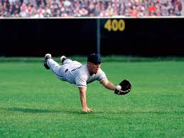
Typical try/catch Structure
try
{
…
}
catch (datatype1 identifier) // exception handler
{
…
}
catch (datatype2 identifier) // exception handler
{
…
}
catch (…) // exception handler
{
…See example except1.cpp and expect2.cpp
}

Slide 23
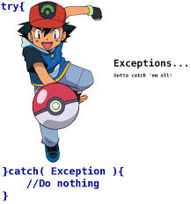
Exception Handling Example
In the following example, Stack is a class that handles exceptions
There are two error scenarios handled by the Stack class
Too many objects put on the stack (exceeding the capacity of the stack (array))
Too many objects popped off the stack (obtaining invalid data)

Slide 24

Details on Exception Handling Example
An exception class, called Range is created
class Range { } - used to connect a throw statement with a catch block
Empty class (not always the case)
When an error occurs, an exception is “thrown” using the keyword “throw”
throw Range( )
Throws the exception
Invokes the implicit constructor for the Range class
The exception class name must include the class in which it is located (Range)
It must immediately follow the try block

Slide 25

Destructors Called Automatically
When an exception is thrown
A destructor is called automatically called for any object that was created by code up to the point in the try block

Slide 26

Details on Exception Handling Example
An exception class can be part of a class
Defined in the public section of the Stack class specification
The exception class name must include the class in which it is located (stack::Range)
It must immediately follow the try block
There can be multiple exceptions within a program
See examples: except3.cpp and except4.cpp

Slide 27

Exceptions with Arguments
Remember when an exception is thrown
An object is created
An exception class can have its own data and member functions
Exceptions with the distance class
See examples: except5.cpp and except6.cpp

Slide 28

More Exception Examples
Missing catch block and (…)
See examples: (except7.cpp and except8.cpp)
Processing after an exception is caught
See example: except9.cpp

Slide 29

C++ Built-in Exceptions
Handles exceptions via a hierarchy of classes
Uses the what function
Returns a string containing the exception object thrown by C++’s built-in exception classes

Slide 30

The Exception Class
The C++ Standard library provides a base class specifically designed to declare objects to be thrown as exceptions
It is called std::exception and is defined in the <exception> header
This class has a virtual member function called “what” that returns a null-terminated character sequence (of type char *) and that can be overwritten in derived classes to contain a description of an exception

Slide 31
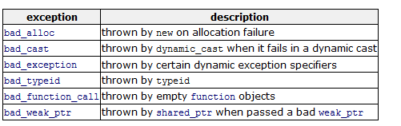

More on the C++ Built-in Exceptions
The exception class contains a function “what” that returns the appropriate error message

Slide 32
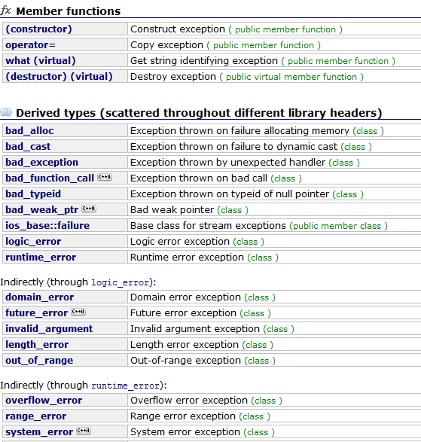
Built-in Exceptions
http://www.cplusplus.com/doc/tutorial/exceptions/

Slide 33

Built-in Exception Examples
See examples: except10.cpp through except14.cpp

